Slide 1
Gypsy Cards
Website (100%)
Facebook
Fiverr
Landing Page
E-Mail: cardsabigail@gmail.com
eBook: ???

Slide 2
TO Dos – Website (General)
TO DO | PT | DE
Check all figure resolutions
Delete „index_image.png“ and „index_image70.png“ from Other Images
Make „About me“ – Foto vom Medi & FB/Instagram
Create a LOG of Website Changes (v1, v2...) | X | X
Reinstall DREAMWEAVER 2015
Add Impressum / Datenschutzerklärung to the Footer [WKO]
Add PT/DE on the Footer
Add YOUTUBE Link to Footer
Add References to „Geschichte.php“ | X | X
Padding between cards in following pages do not appear correctly in IE: significado-das-cartas.php exemplo-1-carta.php exemplo-3-cartas.php carta-do-dia.php
Make a Website Test in all most common browsers and mobiles (<90%)
Use <noscript> in tags where no JavaScript is Available

Slide 3
TO Dos – Website (SEO)
TO DO | PT | DE
Add Meta Tag (Description) | X | X
Add Different Titles to different Pages | X | X
Add hreflang to de and pt sites | X | X
Change >>>AQUI<<</>>>HIER<<< to TIRAGEM PERSONALIZADA / PERSONALISIERTE LEGUNG | X | X
Use H1, H2, H3 in the text ( AVOID using heading tags only for styling text and not presenting structure) | X | X
personalisiert.php → personalisierte-legung.php | X | X
use absolute paths rather than relative paths in “index.php” root (DE/PT) | X | X
Correct sitemaps (DE/PT) | X | X
Update robots.txt to contain ALL files that should not be viwed by the users | X
Changed footer.css & style.css | X | X
Page names (sobre_mim → sobre-mim) | X | X
Add „alt“ to all images → Zigeunerkarte: Tod */ Carta Cigana: Morte* (* from Database) | X | X
Define Keywords and add to text (NOT in Meta Tag)
Leave comments on other blogs adding my WEBSITE
Consider using .htaccess for security reasons
Make a new ERROR 404 Page

Slide 4
TO Dos – Website NEW
TO DO | PT | DE
Change Sie → du (tageskarte.php) |  | X
Change Sie → du (bedeutung-der-karten.php) |  | X
Make Video Thumbnail for Youtube Channel | X | X
Upload Videos FACEBOOK | X | X

Slide 5
Content
Consider creating a new, useful service that no other site
offers. You could also write an original piece of research,
break an exciting news story, or leverage your unique
user base. Other sites may lack the resources or
expertise to do these things.

Slide 6
TO Dos – Next Steps
Landing Page* (Tiragem Personalizada)
Free spread (3 cards) X Email
Enter your Email and get 30% discount on your first spread!
Continue Website Translation (EN)
SEO – how to optimize for google
Google Analytics
* https://colorlib.com/wp/free-bootstrap-landing-pages-templates/

Slide 7
Analyze Competition and Market Size
Facebook Ads Audience (Page already created)
Adwords Keyword Planner (Half of the process done – e-mail used: cardsabigail@gmail.com)
Linkedin Ads Audience (B2B)

Slide 8
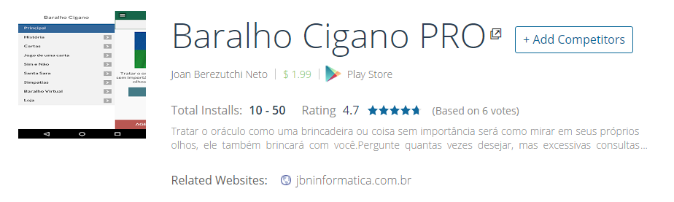
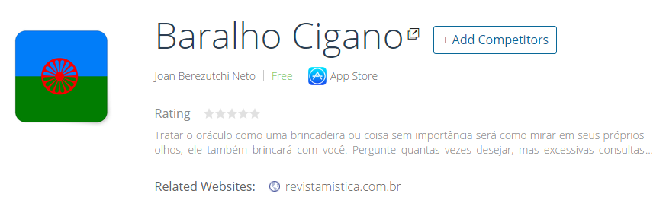
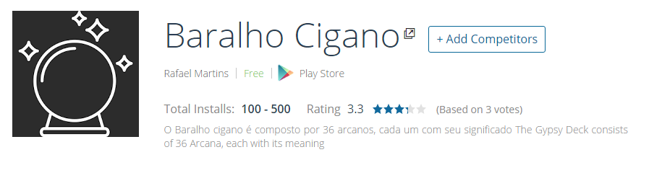
Uncovering Your Competitors
Results from https://www.similarweb.com/

Slide 9
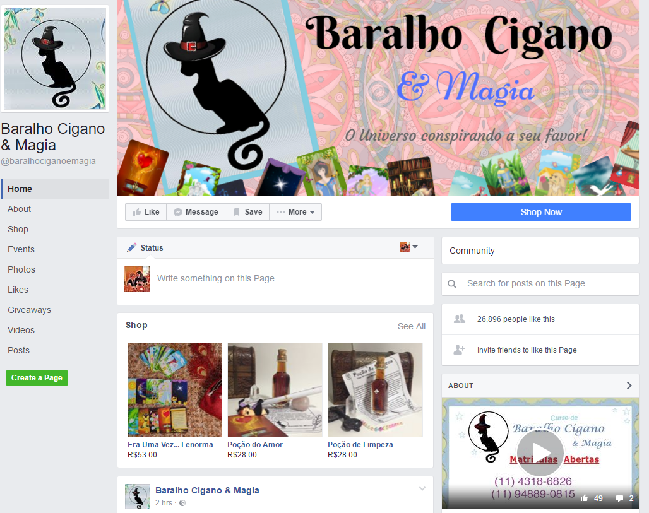
Uncovering Your Competitors
FACEBOOK

Slide 10

Payment Options
Stampartz (Tácito/Andrea)
Tarot Online: Escolha a forma de pagamento: PagSeguro, Paypal, Cartão de Credito Deposito Bancário ou Transferência bancaria: Trabalhamos com os bancos: Bradesco, Brasil, Caixa Econômica Federal, Santander, Real.
Abigail Cards
Depósito bancário BB
Pagseguro – finish login!
Paypal ?

